Slide 1

SURJIN TECH Company Profile
2024. 05
SURJIN GROUP

Slide 2

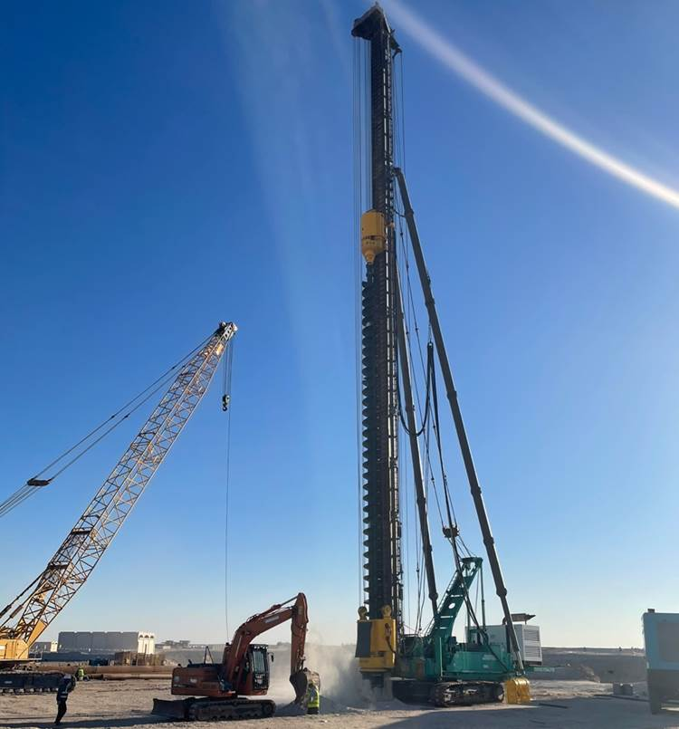
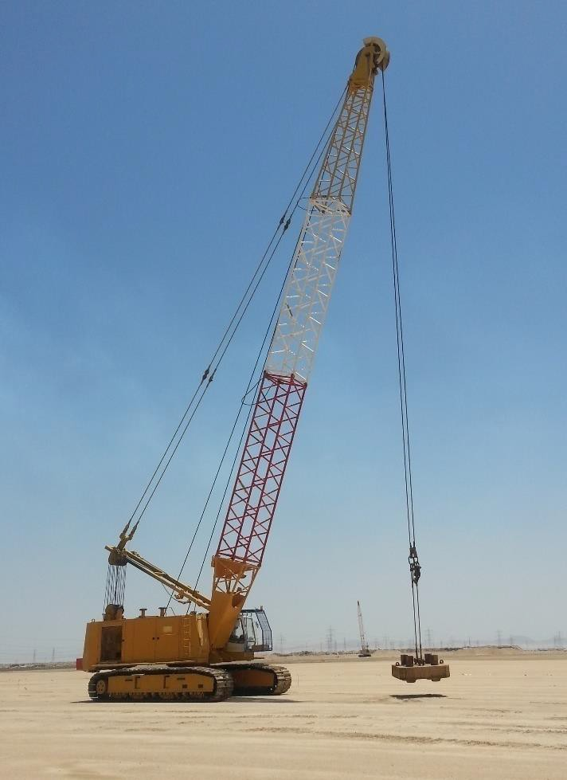
COMPANY PROFILE
SURJIN TECH CO.,LTD
INTRODUCTION TO SURJIN TECH
RM 1114, 254, Beotkkot-ro, Geumcheon-gu, Seoul, Rep. of Korea Tel : +82 (0)70 7435 0020 Fax : +82 (0)2 2113 8810 E-Mail : sjtech81@nate.com Homepage : www.surjintech.co.kr

Slide 3
COMPANY PROFILE
SURJIN TECH CO.,LTD
CONTENT
1. COMPANY PROFILE
2. ORGANIZATION
3. CERTIFICATE STATUS
4. Methods
5. PROJECT PERFORMANCE
6. EQUIPMENT
7. REFERENCE
Notes:
3

Slide 4
COMPANY PROFILE
SURJIN TECH CO.,LTD
1. COMPANY PROFILE
Profile | Remarks
Established | November 1, 2001.
Capital | USD 9.0 Million
Annual Turnover | USD 42 Million (Year 2023)
Employees | 181 (Permanent Only)
Head Office | RM 1114, 254, Beotkkot-ro, Geumcheon-gu, Seoul, Korea
Overseas Office | Saudi Arabia : P.O Box 11557, Zip 31961, Jubail Industrial City Thailand : 264/21-22 Soi 16 Pridi Banomyong (Sukhumvit 71)RD., Prakanogunua, Wattana, Bangkok, Thailand, 10110 Vietnam : No.9B, alley 39, Dinh Thon, Me Tri, Tu Liem, Hanoi Bangladesh : Rupayan Millennium Square, APT No.B-E-10(10th Floor), Cha-69-70, North Badda, Progoti Sarani, Gulshan, Dhaka-1212,
Equipment Depot | Workshop – The Kingdom of Saudi Arabia Warehouse – Korea
Subsidiary Company | Yuhyun Construction Mirae Tech Surjin Industrial Co., Ltd. – Korea Surjin Machinery Co., Ltd. – Korea Surjin Steelform Co., Ltd. – Korea KTF Tech Co., Ltd. – Korea Kyeonghee Yujin Industry

Slide 5






COMPANY PROFILE
SURJIN TECH CO.,LTD
2. ORGANIZATION
CEO
Commercial & Support
Operation
Business Development
Overseas
HR
Engineering
Finance
Construction
Domestic
Machinery

Slide 6
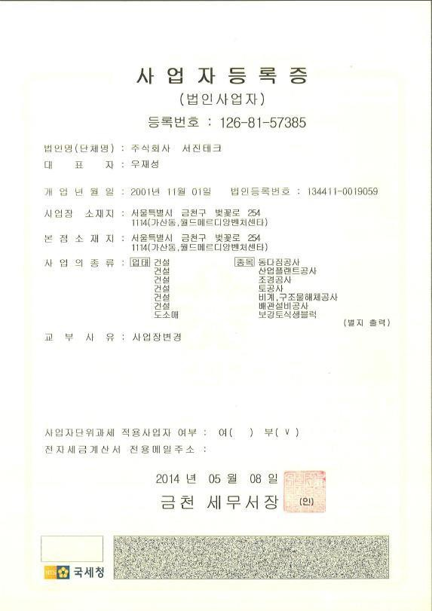
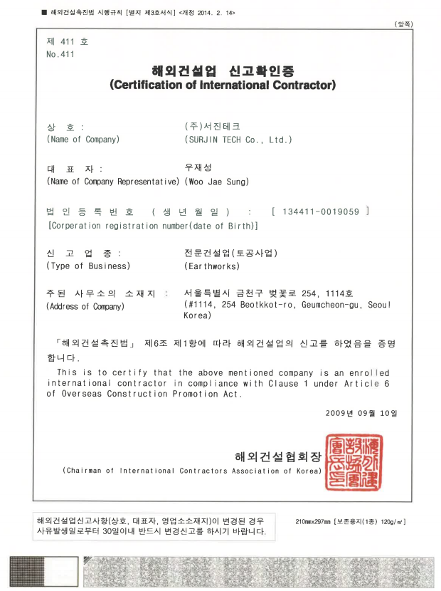
COMPANY PROFILE
SURJIN TECH CO.,LTD
3. CERTIFICATE STATUS
REPUBLIC OF KOREA
Business Registration | Certification of International Contractor

Slide 7
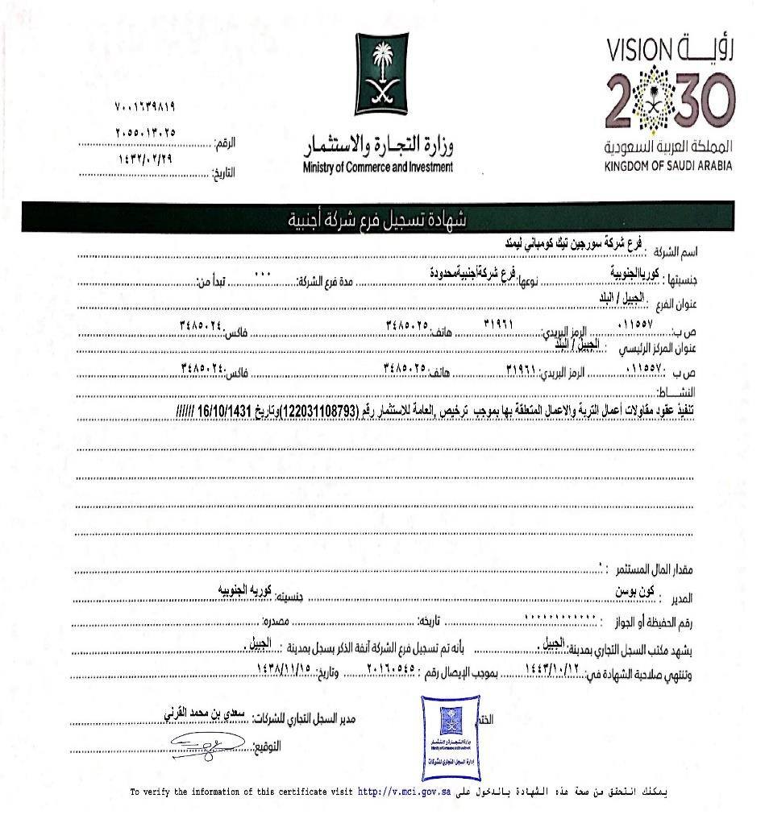
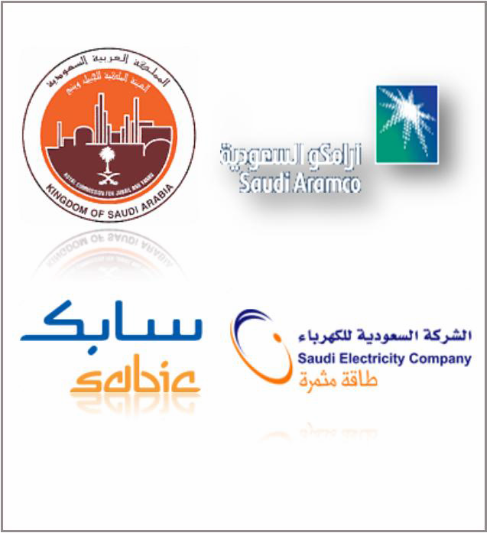
COMPANY PROFILE
SURJIN TECH CO.,LTD
3. CERTIFICATE STATUS
SAUDI ARABIA
Business Registration | SAUDI ARAMCO VENDOR NO. 10046775 ROYAL COMMISSION NO. RCJ000080

Slide 8
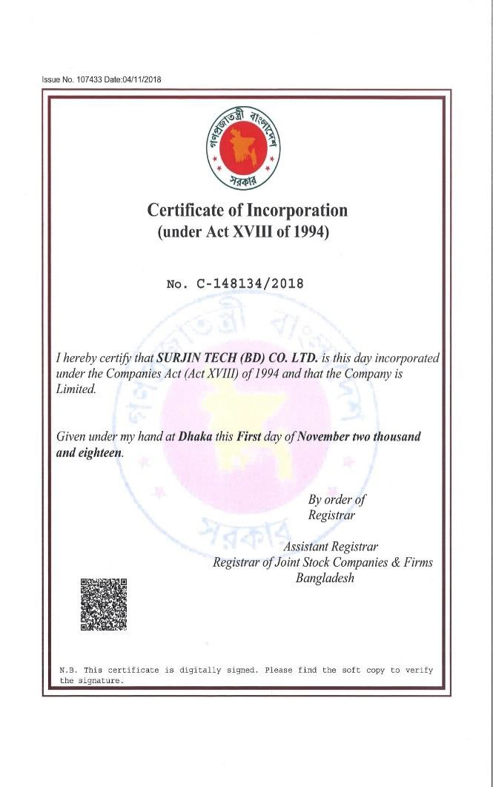
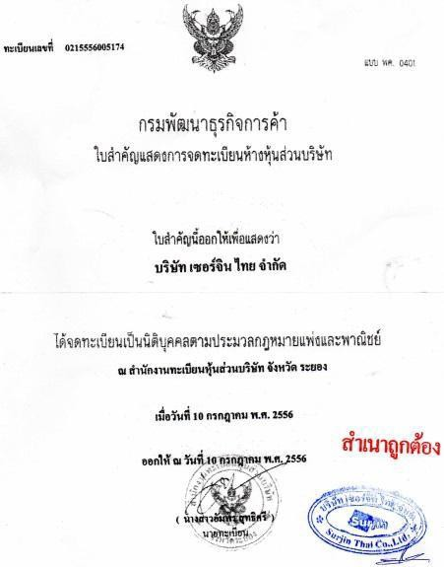
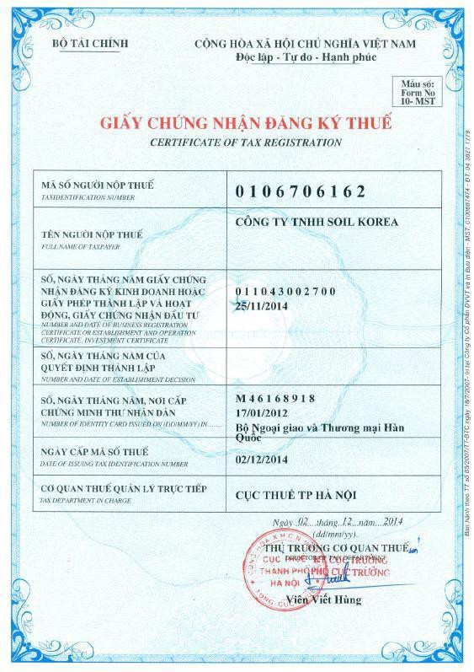
COMPANY PROFILE
SURJIN TECH CO.,LTD
3. CERTIFICATE STATUS
Bangladesh
THAILAND
VIETNAM
Business Registration | Business Registration | Business Registration

Slide 9
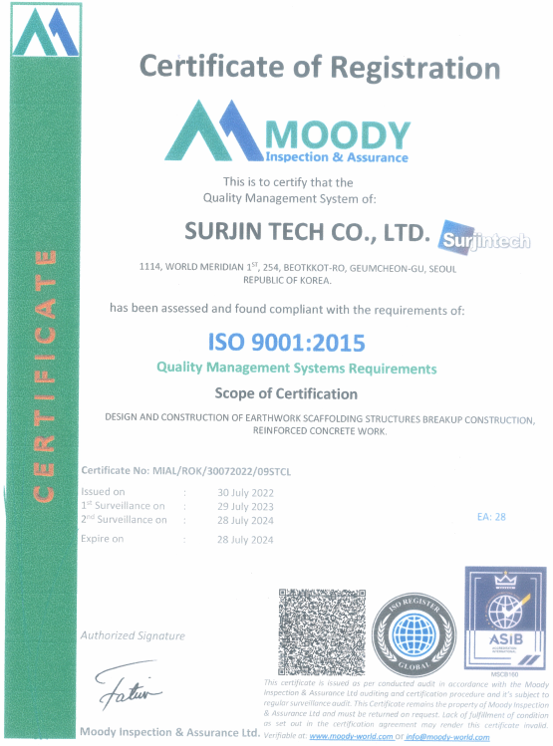
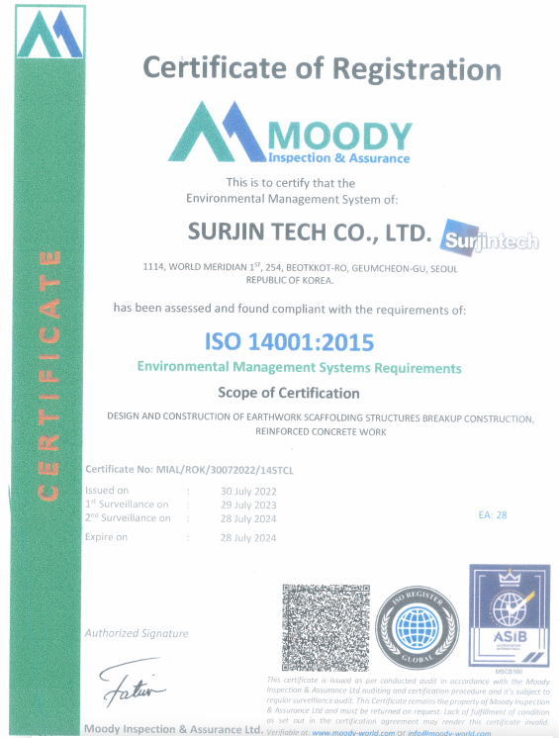
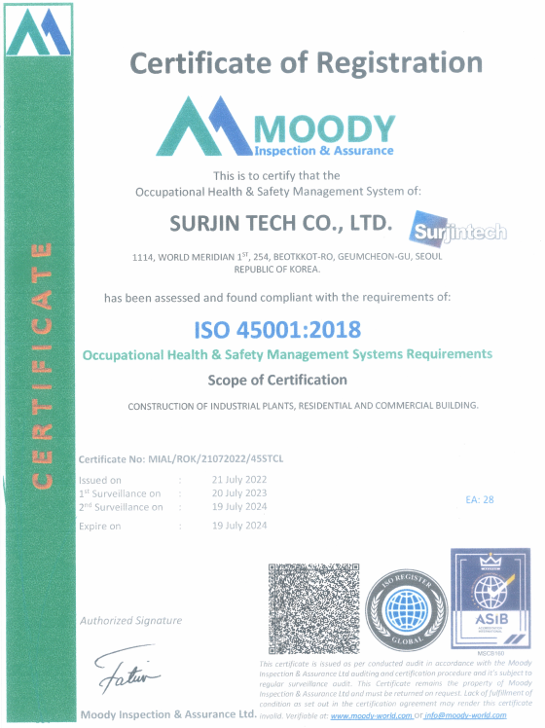
COMPANY PROFILE
SURJIN TECH CO.,LTD
3. CERTIFICATE STATUS
ISO
ISO 9001:2015 (Quality Management System ) | ISO 14001:2015 [Environmental Management System) | ISO 45001:2018 [Occupational Health & Safety Management System)

Slide 10
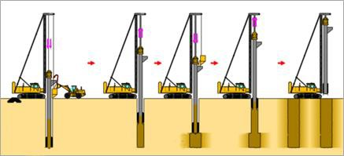
COMPANY PROFILE
SURJIN TECH CO.,LTD
4. Methods
1) Sand Compaction Pile
Sand compaction piles (SCP) of soil improvement techniques act as drains and under favorable conditions can significantly decrease the time for primary consolidation to occur. Furthermore, the construction of sand piles reduces the build-up in pore pressure in granular layers, and hence decreases the soil potential to liquefy during an earthquake. Sand is often readily available near most construction sites, and its considerably less expensive than other processed materials such as crushed stone which may have to be imported from a considerable distance by a considerable cost. Either bottom feed stone column equipment or sand compaction pile equipment can be used to construct sand piles
For this reasons the SCP method was selected for performing theoretical analysis required for improving the foundation soils under the high embankment. In order to apply the SCP method for the case study under consideration, it is important to set up an engineering design that fulfills the basic requirements of soil improvement.
The main geotechnical aspects that should normally be considered in the design and construction of high embankments to be supported on weak soil deposits such as soft cohesive soils and loose sands include the following :
√ Shear Strength and Bearing Capacity of Foundation Soils
√ Soil Deformations (settlements)
√ Embankment stability
√ Soil liquefaction.

Slide 11
COMPANY PROFILE
SURJIN TECH CO.,LTD
4. Methods
2) Dynamic Compaction
The Dynamic Compaction (DC) technique has been proven ver y effective in densification of loose soil within certain depth. The DC technique involves using a crane to drop weights of between 5 to 20 tons, from heights of up to 20m.
As a result the technique is best suited to large, open sites where few obstructions are present.
The impact of the dropped weight induces settlement depths according to the weight
and drop height. The ground is treated by repeatedly dropping the weight onto individual footprints which are arranged on a grid pattern.
Treatment is normally carried out on a number of ‘passes’ with the weight being
dropped a set number of times on a regular drop pattern across the whole treatment
area to constitute a ‘pass’.
The number of drops, weights used and the height of the drops depends on the required post treatment bearing capacity, settlement performance and soil conditions.
First or earlier high energy treatment passes aimed at treating the deeper soil layer and
A final low-energy contiguous tamping pass to compact the shallow near-surface soils disturbed during the earlier high energy treatment passes.

Slide 12
COMPANY PROFILE
SURJIN TECH CO.,LTD
4. Methods
3) Dynamic Replacement
The main Idea behind Dynamic Replacement (DR) is to penetrate and replace loose and soft
soils with dense coarse material.
This will lead to a faster dissipation of pore water pressure.
In the DR method, columns of large diameter(say 2.5m)are formed with granular material in the upper compressible and week soils.
This technique is similar to the Dynamic Compaction, but in this case, pounding is used to form large diameter granular pillars through the soft soils to underlying dense bearing
stratum.
Suitable material for the DR columns is granular material (with elements up to 100mm size). This includes a wide range of possibilities including some kinds of sand, gravel, crushed stone. The material shall contain less than 3% of fines, having a size lower than 0.1mm, and be free from vegetation or organic material.

Slide 13
COMPANY PROFILE
SURJIN TECH CO.,LTD
4. Methods
4) Vibro Flotation (Vibro Compaction)
The concept of the vibro flotation (VF) is a deep compaction technique for densifying sandy soils in place by means of a hydraulic vibrating unit. Under the influence of simultaneous vibration and saturation, loose sand particles are reorganized into a more compact state, and lateral confining pressure within the sand mass is increased.
It is most suitable for non-cohesive soils such as loose sands, gravels and sandy gravels, as well as medium to coarse-grained sand with silt content of less than 12% passing sieve size of 0.074mm and clay content of less than 2 % passing sieve size of 0.005mm. Cohesive soils consisting of silt and clay material would not respond to this method.
The compaction process, consists of a floatation of the soil particles as a result of vibration, which then allows for a rearrangement of the particles in a denser state. So the treated soils have increased density, friction angle and stiffness.

Slide 14
COMPANY PROFILE
SURJIN TECH CO.,LTD
4. Methods
5) Stone Column
The construction of the stone columns (SC) is achieved by penetrating the soil with the Vibro- Probe to the design depth, then feeding stone into the void created by the Vibro-Probe. The construction of the SC progresses upwards in short steps of raising the Vibro-Probe and reintroducing it into the stone cyclically, until the design diameter has been achieved. The technique is used to improve the engineering characteristics of loose granular soils for vibrations inducing densification of the soil surrounding the Vibro-Probe, as well as displacing the soil laterally to allow the placement of the stone backfill for the column formation.
SC is a common and fundamentally more sustainable ground improvement technique available, so increasing the use of recycled aggregates in their construction can achieve significant reduction in the use of finite natural primar y aggregates

Slide 15
COMPANY PROFILE
SURJIN TECH CO.,LTD
4. Methods
6) Cast In Place Pile
The construction of bored piles involves a steel cage to form a void in the soil which is then filled with concrete. Bored piles are installed up to the required depth under working platform including the supply of piling concrete and steel cages.
Stepwise drilling is briefly explained as below ;
The drilling operation is carried out with temporary casing.
Upon drilling of borehole to the required depth, steel cage is inserted in the borehole
by means of crane.
The concrete is pouring using Tremie pipe method.
Concrete is overflowed to remove any bad quality concrete until good quality concrete comes on the ground surface. Thus the piling operation is completed.

Slide 16
COMPANY PROFILE
SURJIN TECH CO.,LTD
4. Methods
7) Sheet Pile
Process
Sheet piles are installed in sequence to design depth along the planned excavation perimeter or seawall alignment. The interlocked sheet piles form a wall for permanent or temporary lateral earth support with reduced groundwater inflow. Anchors can be included to provide additional lateral support if required.
Sheet pile walls have been used to support excavations for below-grade parking structures, basements, pump houses, and foundations, to construct cofferdams, and to construct seawalls and bulkheads.
Advantages
A sustainable option as made of recycled steel and the piles can often be reused
Available in numerous combinations of size and weight
Immediate barrier to prevent soil loss and sloughing during excavation
Permanent sheet piles are designed to provide long service life

Slide 17
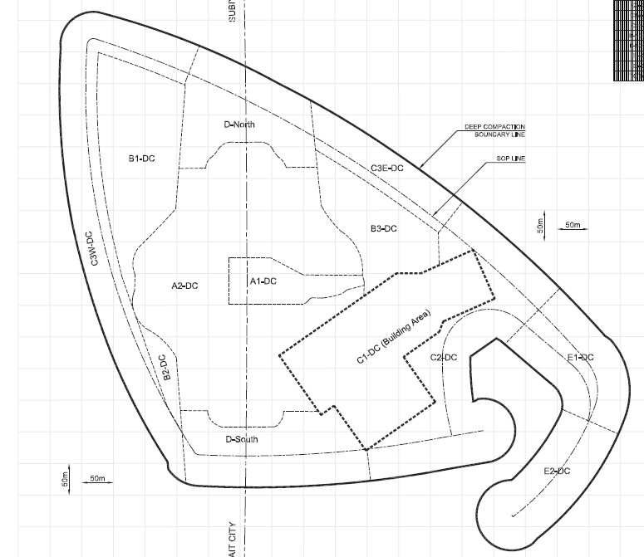
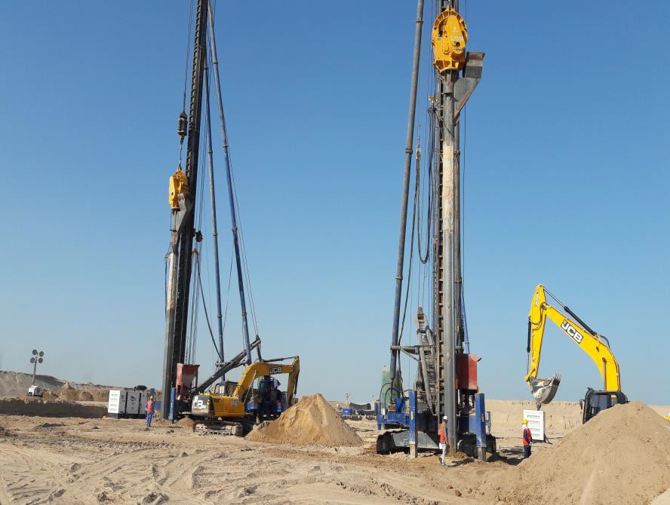
COMPANY PROFILE
SURJIN TECH CO.,LTD
5. PROJECT PERFORMANCE
1) Sand Compaction Pile
▷ SHEIKH JABER CAUSE CAUSEWAY Project, KUWAIT
• Working process : 2017.03 ~ 2018.05
• Quantity : Work Volume = 1,500,000 m3
Client : State of Kuwait Ministry of Public Works and Roads Administration
Main Contractor : HYUNDAI E&C

Slide 18
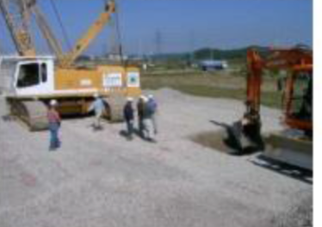
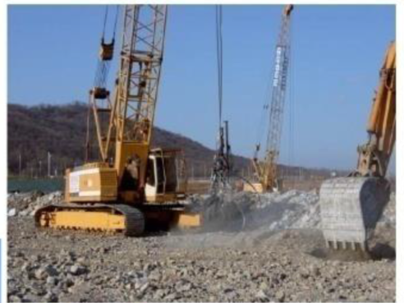
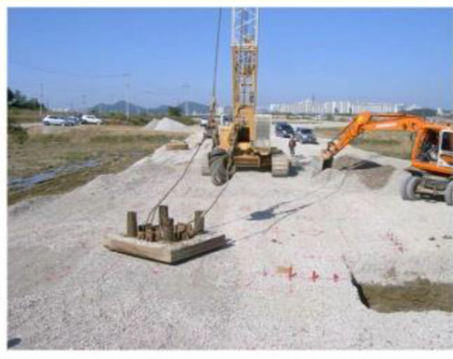
COMPANY PROFILE
SURJIN TECH CO.,LTD
5. PROJECT PERFORMANCE
2) Dynamic Compaction & Dynamic Replacement
▷ PAJU, Unjeong, Detour Road No. 369, KOREA
• Working process : 2007.10 ~ 2008.03
Quantity : (DR) 65,000 m2
Client : Korea National Housing Corporation
Main Contractor : KUMHO E&C

Slide 19
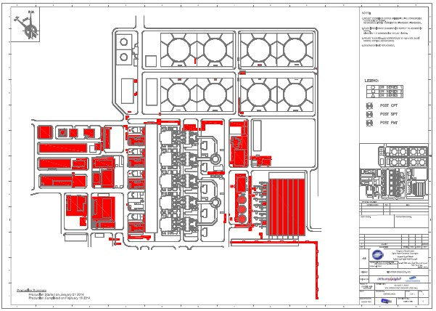
COMPANY PROFILE
SURJIN TECH CO.,LTD
5. PROJECT PERFORMANCE
2) Dynamic Compaction & Dynamic Replacement
▷ YANBU 3 Power Plant Project, SAUDI ARABIA
• Working process : 2013.01 ~ 2015.04
• Quantity : (DC) 130,000 m2, (DR) 60,000 m2
Client : Saline Water Conversion Corporation (SWCC)
Main Contractor : Samsung Engineering

Slide 20
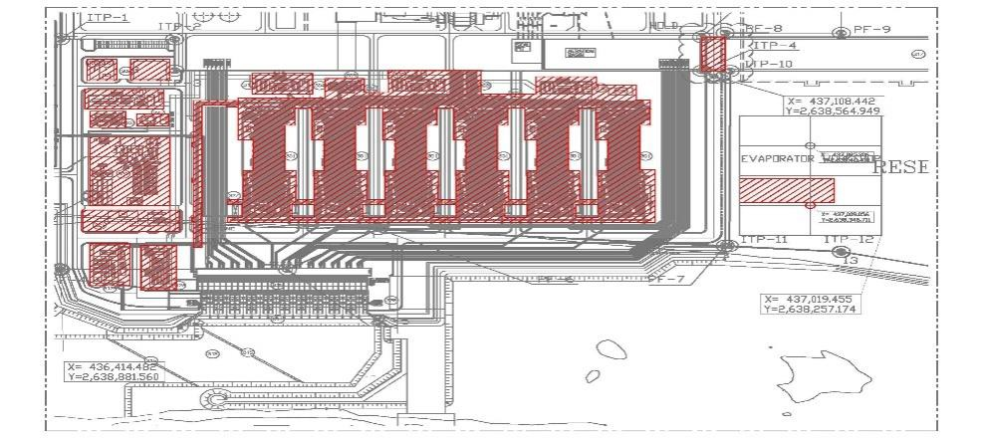
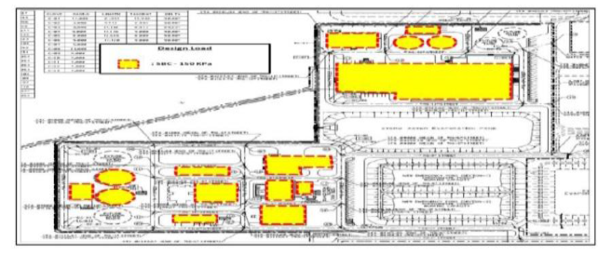
COMPANY PROFILE
SURJIN TECH CO.,LTD
5. PROJECT PERFORMANCE
2) Dynamic Compaction & Dynamic Replacement
▷ YANBU 3 Desalination Plant Project,
SAUDI ARABIA
• Working process : 2013.06 ~ 2014.01
Quantity : (DC) 115,000 m2
Client : Saline Water Conversion Corporation (SWCC)
Main Contractor : Doosan Heavy Industries & Construction
▷ KAUST Research Park Utility Plants Project,
SAUDI ARABIA
• Working process : 2012.12 ~ 2013.02
Quantity : (DC & DR) 40,000 m2
Client : Saudi Aramco
Main Contractor : CNCEC

Slide 21
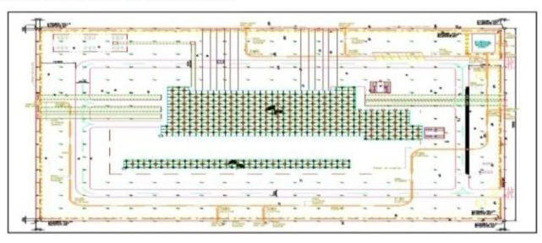
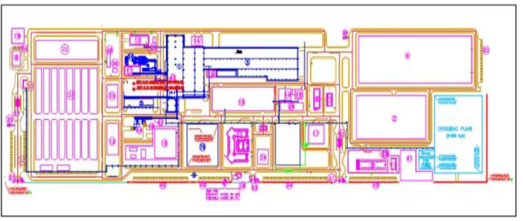
COMPANY PROFILE
SURJIN TECH CO.,LTD
5. PROJECT PERFORMANCE
2) Dynamic Compaction & Dynamic Replacement
▷ EPC of 24 BD Substation project, SAUDI ARABIA
• Working process : 2012.12 ~ 2013.02
Quantity : (DC & DR) 40,000 m2
Client : Saudi Aramco
Main Contractor : CNCEC
▷ JIZAN Economic City South Steel Plant Project,
SAUDI ARABIA
• Working process : 2009.12 ~ 2010.05
Quantity : (DC) 150,600 m2
Client : South Steel Company (SOLB)
Main Contractor : STX E&C

Slide 22
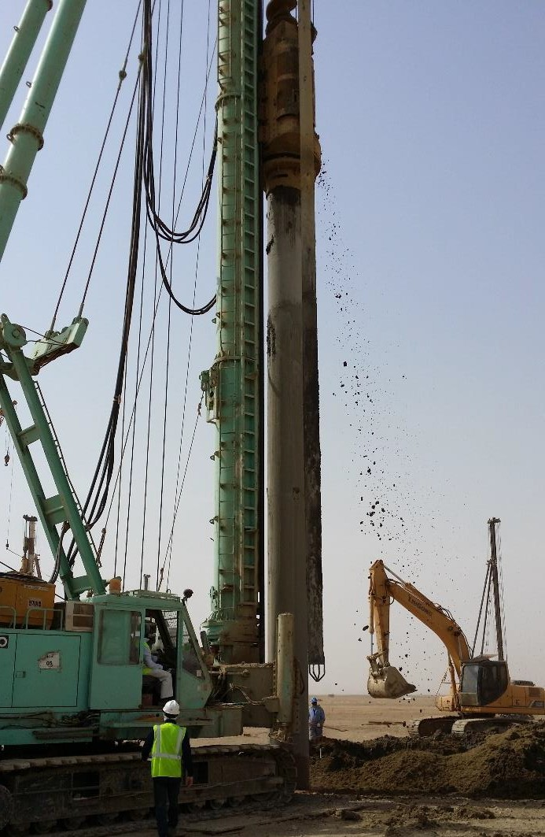
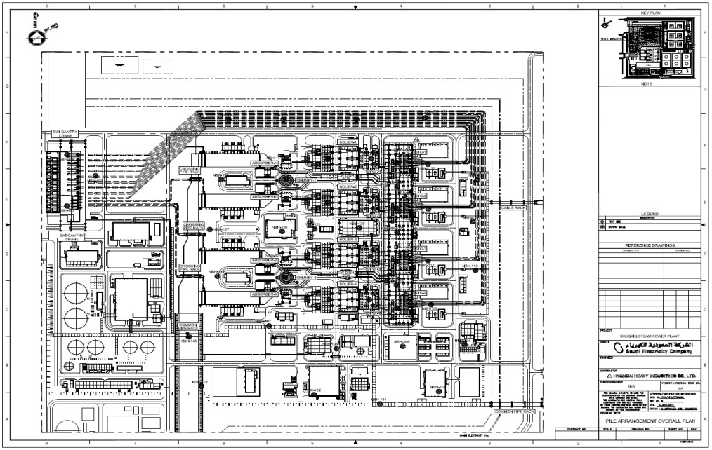
COMPANY PROFILE
SURJIN TECH CO.,LTD
5. PROJECT PERFORMANCE
3) Pile (CIP)
▷ SHUQAIQ Steam Power Plant Project,
SAUDI ARABIA
– Working process : 2014.02 ~ 2015.04
Quantity : (CIP) 55,000 m
Client : Saudi Electricity Company (SEC)
Main Contractor : Hyundai Heavy Industries (HHI)

Slide 23
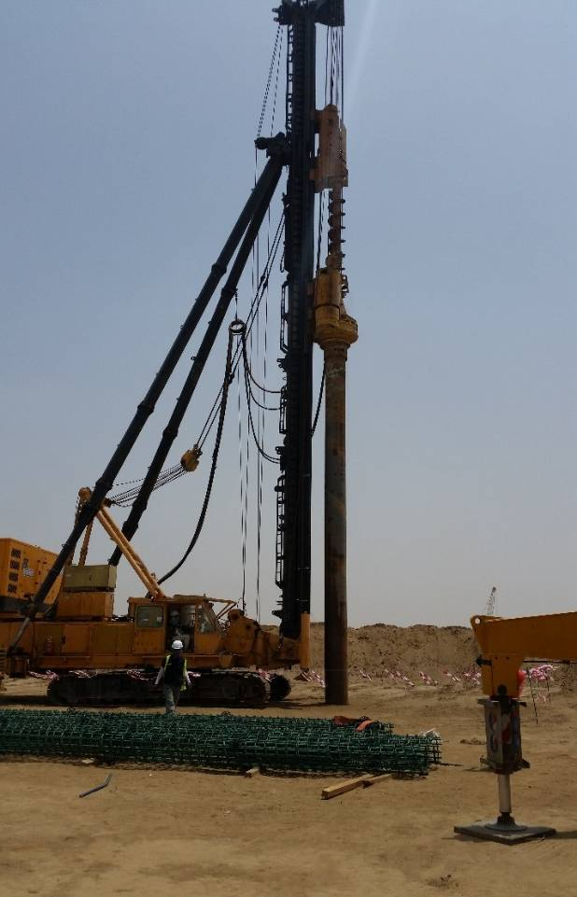
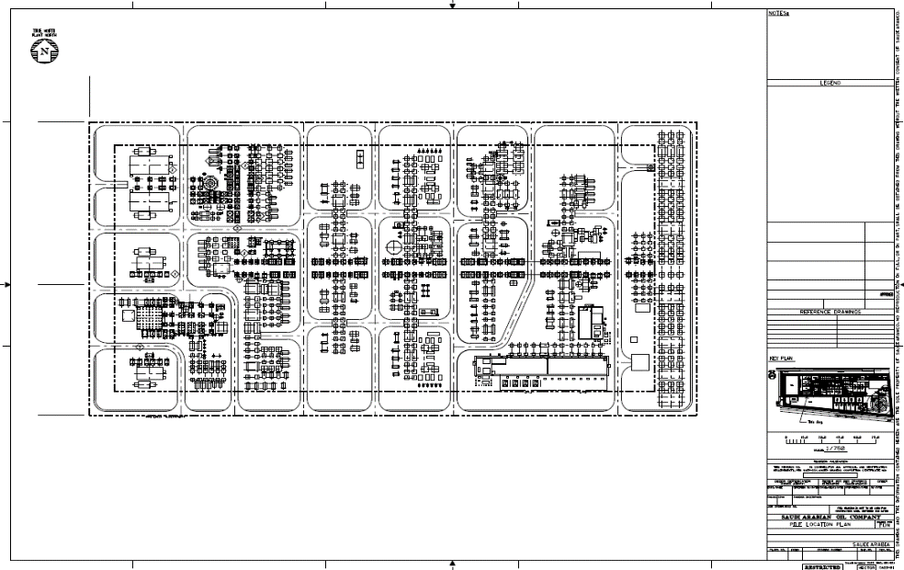

COMPANY PROFILE
SURJIN TECH CO.,LTD
5. PROJECT PERFORMANCE
3) Pile (CIP)
JAZAN Integrated Gasification combined Cycle,
SAUDI ARABIA
Working process : 2015.04 ~ 2015.09
Quantity : (CIP) 25,000 m
Client : Saudi Aramco
Main Contractor : SEPCO

Slide 24
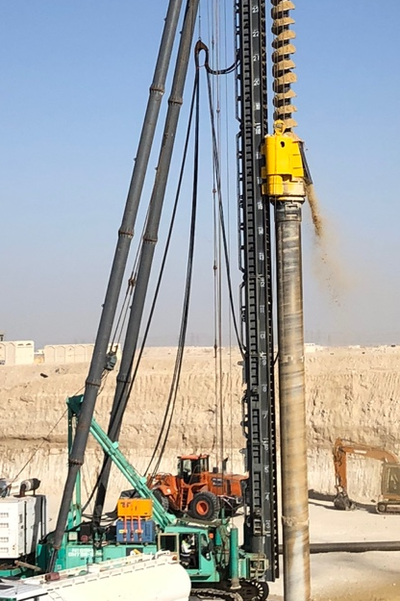
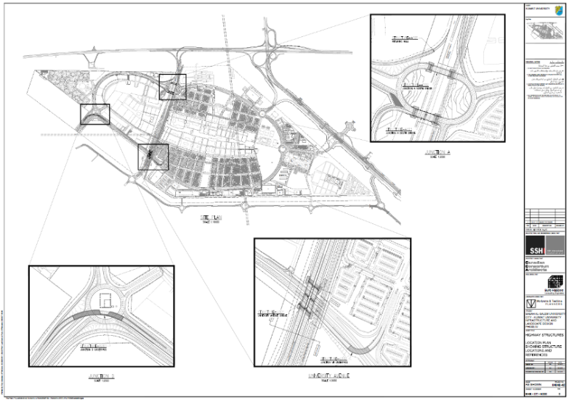
COMPANY PROFILE
SURJIN TECH CO.,LTD
5. PROJECT PERFORMANCE
3) Pile (CIP)
Structure A103 & D201 Junction A & D of
Kuwait University, KUWAIT
Working process : 2020.02 ~ 2020.07
Quantity : (CIP) 17,000 m
Client : Kuwait University
Main Contractor : Al Kharafi

Slide 25
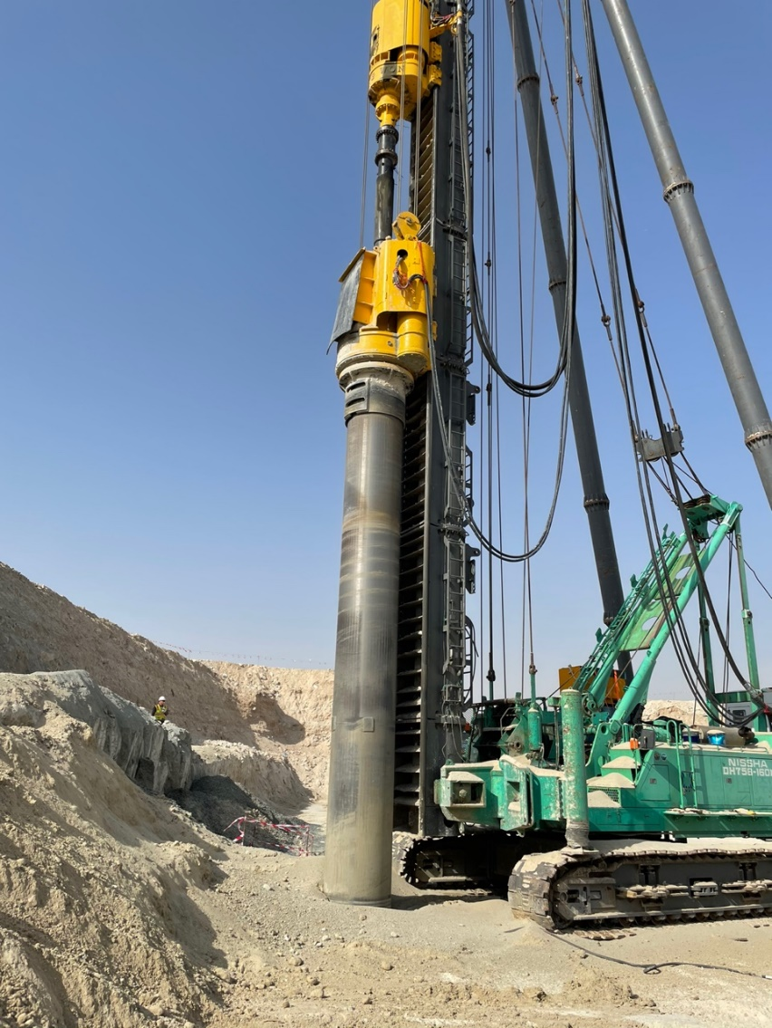
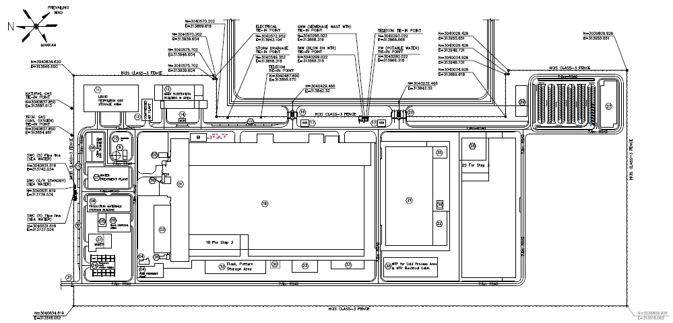
COMPANY PROFILE
SURJIN TECH CO.,LTD
5. PROJECT PERFORMANCE
3) Pile (CIP)
TUWAIQ Casting and Forging Facility,
Saudi Arabia
Working process : 2022.02 ~ 2022.12
Quantity : (CIP) 47,000 m
Client : TUWAIQ
Main Contractor : Doosan Enerbility

Slide 26
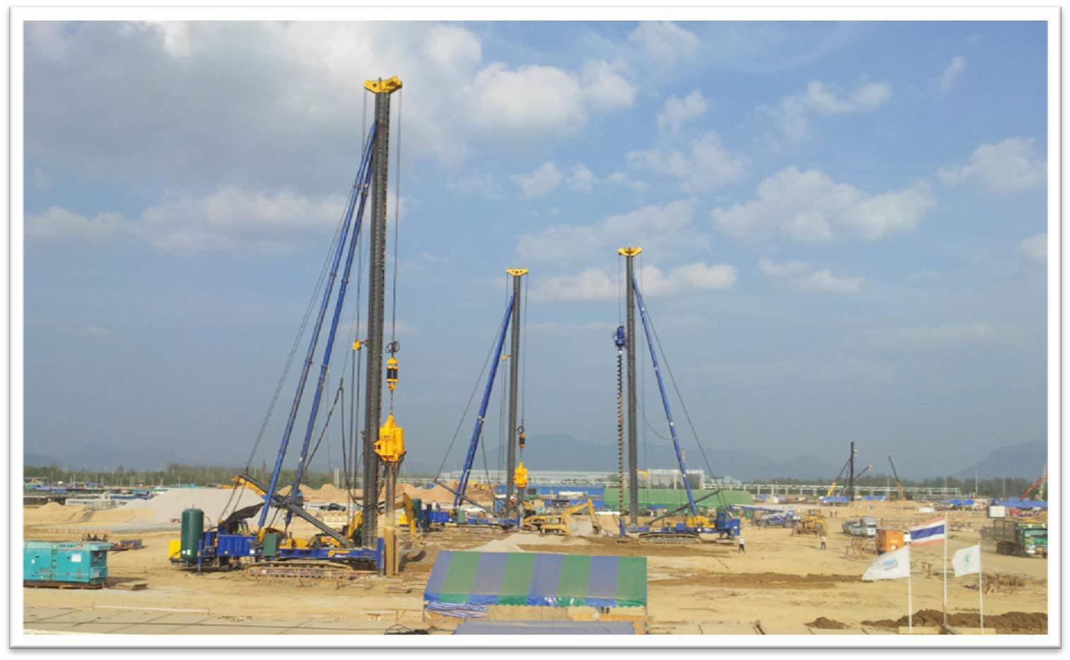
COMPANY PROFILE
SURJIN TECH CO.,LTD
5. PROJECT PERFORMANCE
4) Stone Column (Dry Type)
▷ IRPC UHV Project, THAILAND
Working process : 2013.7 ~ 2014.5
Quantity : 30,000m
Client : IRPC
Main Contractor : SK E&C

Slide 27
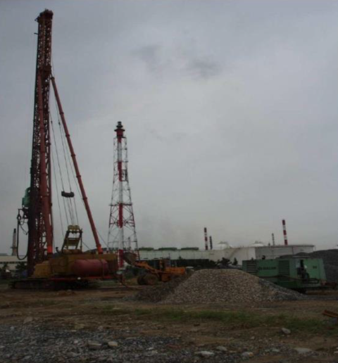
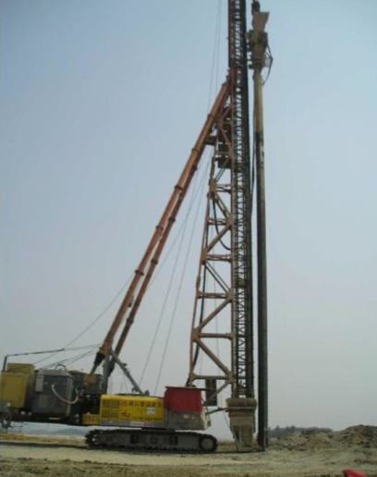
COMPANY PROFILE
SURJIN TECH CO.,LTD
5. PROJECT PERFORMANCE
4) Stone Column (Dry Type)
▷ DANGJIN 3rd Blast Furnace, KOREA
• Working process : 2012.03 ~ 2012.06
Quantity : 60,000 m
Client : Hyundai Steel
Main Contractor : Hyundai Heavy Industries
▷ SAEMANGEUM Dikes Dongjin Zone 5, KOREA
• Working process : 2011.04 ~ 2012.02
Quantity : 120,000 m
Client : Korea Rural Community corporation
Main Contractor : Hyundai Development Company

Slide 28

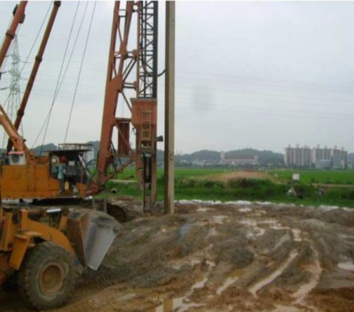
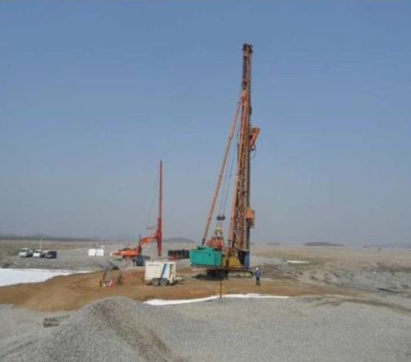
COMPANY PROFILE
SURJIN TECH CO.,LTD
5. PROJECT PERFORMANCE
4) Stone Column (Dry Type)
▷ ILLO-MONGTAN State Support Local Road
Extended Paving Construction, KOREA
• Working process : 2011.12 ~ 2012.05
Quantity : 80,000 m
Client : Jeolla Namdo
Main Contractor : Daejin General Construction
▷ YEONGJONG Sky City Development Special
Structure Construction (Zone 3), KOREA
• Working process : 2011.05 ~ 2011.09
Quantity : 70,000 m
Client : Korea Land & Housing Corporation
Main Contractor : Kukdong E&C

Slide 29
COMPANY PROFILE
SURJIN TECH CO.,LTD
6. EQUIPMENT
1) Dynamic Compaction & Dynamic Replacement
Equipment | Quantity | Remarks
Crane 150ton | 1 | Liebherr
Crane 120ton | 3 | Liebherr
Crane 80ton | 2 | Liebherr
Iron Pounder | 30
2) Stone Column & Vibro Flotation
Equipment | Quantity | Remarks
Stone Colum Pile - Long Auger Drilling Rig (120 Ton) | 6 | CHTC Jove
Vibro-Probe (Ø 600~1,000 mm) | 6
Power-Pack (330 Bar) | 3
3) Sand Compaction Pile
Equipment | Quantity | Remarks
Sand Compaction Pile - Long Auger Drilling Rig (120 Ton) | 10 | CHTC Jove

Slide 30
COMPANY PROFILE
SURJIN TECH CO.,LTD
6. EQUIPMENT
4) Board Pile (C.I.P) & Sheet Pile
Equipment | Quantity | Remarks
Pile Driver 758 (160 Ton) | 3 | Nippon Sharyo
Pile Driver 608 (120 Ton) | 2 | Nippon Sharyo
Pile Driver 508 (105 Ton) | 2 | Nippon Sharyo
Pile Driver SC700 | 1 | Sumitomo
Vibro Hammer (12 Ton) | 5 | Sheet Pile
Screw Auger(Max Ø 1,000mm) | 5
Casing Auger(Max Ø 1,000mm) | 6
5) Concrete Batching Plant
Equipment | Quantity | Remarks
Concrete Batching Plant (180 ㎥/hr) | 1 | DMI
Concrete Batching Plant (120 ㎥/hr) | 1 | DMI
Water Chiller Plant (200 ㎥/day) | 1 | KTI
Ice Plant(51 Ton/hr) | 1 | KTI
Concrete Mixer Truck (9㎥) | 14 | Sinotruk
Concrete Pump Truck (42m) | 4 | Daewoo

Slide 31
COMPANY PROFILE
SURJIN TECH CO.,LTD
6. EQUIPMENT
6) Common
Equipment | Quantity | Remarks
Crawler Crane 155ton | 1 | Manitowoc
Crawler Crane 100ton | 5 | XCMG
Crawler Crane 65ton | 2 | Kobelco
Crawler Crane 55ton | 1 | Kobelco
Crawler Crane 50ton | 2 | XCMG
Wheel Crane 70ton | 1 | Manitowoc
Wheel Crane 45ton | 1 | Manitowoc
Excavator | 4 | Doosan
Wheel Loader (4㎥) | 2 | Doosan
Boring Machine | 2 | SPT
CPT Machine | 1 | CPT
Generator(25kw-500kw) | 21
Tower light | 13
Fork Lift | 3
Air Compressor | 12
Water Pump | 7

Slide 32
COMPANY PROFILE
SURJIN TECH CO.,LTD
7. REFERENCE
SCP : Sand Compaction Pile SSCP: Static Sand Compaction Pile
1) Sand Compaction Pile [SCP]
NO | PROJECT NAME | COUNTRY | OWNER | MAIN CONTRACTOR | WORK PERIOD | SCOPE | QUANTITY(m)
1 | Ulsan National Industrial Complex (Yongyeon~ Cheongnyang IC) Connection Road Construction | Korea | Ulsan Metropolitan City | GS E&C | 2011.05~2012.06 | SCP | 225,500
2 | Ulsan New Port Pier Connection Road Construction | Korea | Ulsan Metropolitan City | GS E&C | 2011.09 | SCP | 14,100
3 | Paengseong-Oseong Road Construction | Korea | Pyeongtaek City | Keumho Polychem | 2011.11~2011.12 | SCP | 16,000
4 | Keumho Polychem YEP IV€ site additional ground improvement work | Korea | Keumho Polychem | Keumho Polychem | 2012.02~2013.06 | SCP | 125,000
5 | Seocheon-Boryeong (Section 1) Road Construction | Korea | Daejeon Regional Land Management Office | Daelim Construction | 2012.05~2012.07 | SCP | 48,500
6 | Haengju Bridge South Road Network Comprehensive Improvement Road Construction | Korea | Seoul Regional Land Management Office | - | 2012.07~2013.03 | SCP | 83,900
7 | Suin Line Ansan City Section Semi-Underground Project | Korea | Korea Rail Network Authority | Ssangyong Construction | 2012.07~2013.04 | SCP | 86,100
8 | Hampyeong Nabi Industrial Zone Construction | Korea | Hampyeong-gun | Dongkwang Construction | 2015.06~2015.10 | SCP | 11,000
9 | Gwangyang City National Road Alternative Bypass Road Construction Work | Korea | Ministry of Land, Transport and Maritime Affairs | GS E&C | 2012.10~2013.01 | SCP | 31,000
10 | Sihwa MTV Traffic Improvement Measures Road Construction | Korea | - | Daelim Construction | 2013.01~2013.03 | SCP | 27,000
11 | Songsan National Road 77 Construction | Korea | Seoul Regional Land Management Office | Posco E&C | 2013.03~2013.06 | SCP | 64,400

Slide 33
COMPANY PROFILE
SURJIN TECH CO.,LTD
7. REFERENCE
1) Sand Compaction Pile [SCP]
NO | PROJECT NAME | COUNTRY | OWNER | MAIN CONTRACTOR | WORK PERIOD | SCOPE | QUANTITY(m)
12 | Iksan-Daeya Double Track Railway Section 1 Roadbed Construction | KOREA | Korea National Railway | Tosung Construction | 2013.09~2013.10 | SCP | 18,000
13 | Galsa Bay Access Road Line 2 Connection Road Roadbed Construction | KOREA | Gwangyang Bay Area Economic Administration | Woojin Construction | 2013.10~2014.04 | SCP | 55,000
14 | Gunjang National Industrial Complex Ip-Ip Railway Section 1 Roadbed Construction | KOREA | Korea Railroad | Jun Construction | 2013.11~2014.04 | SCP | 80,000
15 | Sihwa MTV Broad Road Construction | KOREA | K-Water Corp | Dongwoon Engineering | 2013.11~2014.01 | SCP | 38,300
16 | SHEIKH JABER CAUSE CAUSEWAY Project, KUWAIT | KUWAIT | Kuwait Ministry of Public Works | Hyundai E&C | 2017.05.10~ 2017.10.10 | SCP | 250,000 | 1,500,000 m3
17 | SHEIKH JABER CAUSE CAUSEWAY Project, KUWAIT | KUWAIT |  | Hyundai E&C | 2017.10.11~ 2019.09.30 | SCP | 370,000
18 | Songsan Green City Southern District Development Project Package 3 | KOREA | Korea Water Resources Corporation | Jangcha Construction | 2021.04~2021.12 | SCP | 97,000
19 | Saemangeum North-South Road Construction Phase 1 (Section 4) Soft Ground Improvement | KOREA | Korea Public Procurement Service | SK Ecoplant | 2018.05~2020.03 | SCP | 151,000
20 | Shinansanseon Double Track Train Private Investment Project Package 6 | KOREA | Nextrain Co.,Ltd | Dongheung Development Company | 2021.06~2022.05 | SCP | 413,000
21 | Soft Soil Improvement Work for the Road From Hanlim to Saenglim | KOREA | Korea Expressway Corporation | Samsung C&T | 2020.08~2020.12 | SCP | 6,500
22 | Gunja Baegot New City Seohaeanro Detour Road Project | KOREA | Siheung City | Youngtak Construction | 2020.07~2020.08 | SCP | 9,300
 | TOTAL | SCP | 2,220,600
SCP : Vibrating Sand Compaction Pile SSCP: Static Sand Compaction Pile

Slide 34
COMPANY PROFILE
SURJIN TECH CO.,LTD
7. REFERENCE
2) Static Sand Compaction Pile [SSCP]
NO | PROJECT NAME | COUNTRY | OWNER | MAIN CONTRACTOR | WORK PERIOD | SCOPE | QUANTITY(m)
1 | Saemangeum North-South Road Construction Phase 1 (Section 4) Soft Ground Treatment | KOREA | Public Procurement Service | SK E&C | 2018.05~2020.12 | SSCP | 10,000
2 | Saemangeum-Jeonju Expressway Construction (Section 1) | KOREA | Korea Expressway Corporation | GS E&C | 2019.08~2021.12 | SSCP | 498,000
3 | Gwangyang Port Seonghwang Viaduct Construction | KOREA | Yeosu Regional Office of Oceans and Fisheries | Namkwang E&C | 2019.05~2019.07 | SSCP | 15,000
4 | Hallim-Saengrim connection road construction | KOREA | Kyeongsangnam-do Province Hall | Samsung C&T | 2020.09~2020.12 | SSCP | 67,000
5 | Songsan Green City Construction, Zone 3 | KOREA | Korea Water Resources Corporation | Daelim Contruction | 2021.04~2022.03 | SSCP | 72,000
6 | Songsan Green City Construction, Section 2 | KOREA | Korea Water Resources Corporation | Kangsan Construction | 2021.09~Ongoing | SSCP | 196,500
7 | Sinansan Line Section 6 | KOREA | Korea Rail Network Authority | Posco E&C | 2021.05~Ongoing | SSCP | 265,500
8 | Seohaean-ro bypass road construction work | KOREA | Siheung City | Ace Construction | 2021.07~Ongoing | SSCP | 13,265
9 | Donggimhae IC ~ Sikmangan Road | KOREA |  | Namkwang E&C | 2021.07~2021.12 | SSCP | 120,000
SCP : Vibrating Sand Compaction Pile SSCP: Static Sand Compaction Pile

Slide 35
COMPANY PROFILE
SURJIN TECH CO.,LTD
7. REFERENCE
2) Static Sand Compaction Pile [SSCP]
NO | PROJECT NAME | COUNTRY | OWNER | MAIN CONTRACTOR | WORK PERIOD | SCOPE | QUANTITY(m)
10 | Saemangeum North-South Road Construction Phase 1 (Section 4) Soft Ground Treatment | KOREA | Public Procurement Service | SK E&C | 2018.05~2020.12 | SSCP | 10,000
11 | Saemangeum-Jeonju Expressway Construction (Section 1) | KOREA | Korea Expressway Corporation | GS E&C | 2019.08~2021.12 | SSCP | 498,000
12 | Gwangyang Port Seonghwang Viaduct Construction | KOREA | Yeosu Regional Office of Oceans and Fisheries | Namkwang E&C | 2019.05~2019.07 | SSCP | 15,000
13 | Saemangeum Expressway Project Package 1 | KOREA | Korea Expressway Corporation | Mirae Geotech Lab Company Limited | 2019.02~2021.11 | SSCP | 425,000
14 | Songsan Green City Development Project Package 2 | KOREA | Korea Water Resources Corporation | Dream Heavy Industries | 2021.09~2022.08 | SSCP | 196,000
15 | Wando Cheongryongcheon River Disaster Prevention Project | KOREA | Wando-gun | Mirae Geotech Lab Company Limited | 2021.10~2022.05 | SSCP | 127,000
 | TOTAL | SSCP | 2,528,265
SCP : Vibrating Sand Compaction Pile SSCP: Static Sand Compaction Pile

Slide 36
COMPANY PROFILE
SURJIN TECH CO.,LTD
7. REFERENCE
3) Dynamic Compaction & Dynamic Replacement
NO | PROJECT NAME | COUNTRY | OWNER | MAIN CONTRACTOR | WORK PERIOD | SCOPE
1 | E-1 Project | KOREA | ODPEL TERMINAL | SEONJIN | Jan.03 ~ Feb.03 | DC
2 | Kumho bestvill apartment | KOREA | KUMHO CONST. | KUMHO | Jan.03 ~ Mar.03 | DC
3 | Poonglim I-one apartment | KOREA | ILJU CONST. | POONGLIM | Feb.03 ~ Mar.03 | DC
4 | Yulchon complex thermal power plant | KOREA | YULCHON POWER | HYUNDAI | Feb.03 ~ Jul.03 | DC
5 | Songdo Knowledge information – Industrial infrastructure | KOREA | INCHEON CITY | DONGIL | Feb.03 ~ Jul.04 | DC
6 | Kunjang new container port terminal site | KOREA | BRMAPA | HYOSUNG | Jul.04 ~ May.05 | DC
7 | Songdo green zone development | KOREA | INCHEON CITY | SK E&C | Dec.04 ~ Mar.05 | DC
8 | Nongshim industial areas | KOREA | NONGSHIM | DAESOL E. | Jul.06 ~ Nov.06 | DC
DC: Dynamic Compaction ㆍDR: Dynamic Replacement

Slide 37
COMPANY PROFILE
SURJIN TECH CO.,LTD
7. REFERENCE
3) Dynamic Compaction & Dynamic Replacement
NO | PROJECT NAME | COUNTRY | OWNER | MAIN CONTRACTOR | WORK PERIOD | SCOPE
9 | Development of infrastructure ofSongdo | KOREA | INCHEON CITY | WOOSEOK | Jun.07 ~ Nov.08 | DC
10 | Doosan Infracore Kunsan Plant | KOREA | DOOSAN Infracore | DOOSAN | Dec.07 ~ Jul.08 | DC
11 | Songdo jack-nicklaus golf club | KOREA | NSIC | POSCO E&C | May.08 ~ Nov.08 | DC
12 | Dock and quay for Kunsan Shipyard | KOREA | HHI | HAUNDAI Ind | Jun.08 ~ Sep.08 | DC
13 | S-Oil Osan refinery expansion pjt | KOREA | S-OIL | SAMSUNG ENG | Mar.09 ~ Apr.09 | DC
14 | South steel plant project | Saudi Arabia | SOUTH STEEL | STX | Dec.09 ~ Jun.10 | DC
15 | Yanbu Export Refinery Project | Saudi Arabia | ARAMCO | SK E&C | Jan.11 ~ Jun.11 | DC/DR
16 | Wasit gas plant project | Saudi Arabia | ARAMCO | SK E&C | Sep.11 ~ May.12 | DC/DR
DC: Dynamic Compaction ㆍDR: Dynamic Replacement

Slide 38
COMPANY PROFILE
SURJIN TECH CO.,LTD
7. REFERENCE
3) Dynamic Compaction & Dynamic Replacement
NO | PROJECT NAME | COUNTRY | OWNER | MAIN CONTRACTOR | WORK PERIOD | SCOPE
17 | Yeongjong Sky City Development Special ST | KOREA | KLHC | KUKDONG E&C | May.11 ~ Sep.11 | DC
18 | Jubail 24 BD Substation | Saudi Arabia | SEC | AL MASHARIQ | Oct.12 ~ Dec.12 | DC
19 | KAUST Research Park Utility | Saudi Arabia | ARAMCO | CNCEC | Dec.12 ~ Jan.13 | DC/DR
20 | KAUST Flood Control | Saudi Arabia | ARAMCO | NBH | Mar.13 ~ May.13 | DR
21 | Yanbu 3 Desalination | Saudi Arabia | SWCC | DOOSAN | Jun.13 ~ Jan.14 | DC
22 | Construction of New AL LAITH Substation | Saudi Arabia | DELTA | DELTA | SEP.14 ~ SEP.14 | DC
23 | Yanbu 3 Desalination | Saudi Arabia | SWCC | DOOSAN | Sep.15 ~ Oct.15 | DC
24 | Dhahran Home Ownershop Project | Saudi Arabia | SEC | NCC | Jul.16 ~ Feb.17 | DC
25 | Shoaiba Ph.4 RO Desalination Plant | Saudi Arabia | SWCC | DOOSAN | Jan.17 ~ Mar.18 | DC/DR
26 | Al-Khobar RO Desalination Plant | Saudi Arabia | SWCC | Safe Track | Oct.18~Feb.19 | DC
DC: Dynamic Compaction ㆍDR: Dynamic Replacement

Slide 39
COMPANY PROFILE
SURJIN TECH CO.,LTD
7. REFERENCE
4) Cast In Place Pile
NO | PROJECT NAME | COUNTRY | OWNER / MAIN CONTRACTOR | WORK PERIOD | SCOPE
1 | Maadi Sewage Project | Egypt | CONCORD | Aug.10 ~ Dec.10 | CIP
2 | Jeddah 110Kv OTH Line Shoaibah | Saudi Arabia | SCECEO | Sep.10 ~ Apr.11 | CIP
3 | MARAFIQ SWTP-9 PJT | Saudi Arabia | MARAFIQ | Dec.10 ~ Sep.11 | CIP
4 | Haramain Highspeed Railways | Saudi Arabia | AL RAHJI AlLIANCE | Mar.11 ~ Dec.11 | CIP
5 | Kayan Reactor Project | Saudi Arabia | KAYAN / BEDRAN | Jun.12 ~ Jul.12 | CIP
6 | Tech Building of Mobile Company | Saudi Arabia | Mobily / COMMITCO | Oct.12 ~ Nov.12 | CIP
7 | Shuqaiq Steam Power Plant | Saudi Arabia | SEC / HHI | Feb.14 ~ Apr.15 | CIP
8 | Jeddah South Thermal Power Plant | Saudi Arabia | SEC / HHI | Mar.14 ~ Jul.14 | CIP
9 | Jazan Integrated Gasification combined Cycle Project | Saudi Arabia | ARAMCO / SEPCO | Apr.15 ~ Sep.15 | CIP
10 | Ma'aden Umm Wu' Al Project | Saudi Arabia | Ma'aden/GEC | Apr.16 ~ Aug.16 | CIP
CIP : Cast In-placed Pile (BORED PILE)

Slide 40
COMPANY PROFILE
SURJIN TECH CO.,LTD
회사 소개
7. REFERENCE
4) Cast In Place Pile
NO | PROJECT NAME | COUNTRY | OWNER / MAIN CONTRACTOR | WORK PERIOD | SCOPE
11 | HWY 40, R 270 and Bridge | Kuwait | UGCC | May.17 ~ Dec.17 | CIP
12 | Hessah Al Mubarak District Grand Sea Tower | Kuwait | First Group Company | Oct.19 ~ Jan.20 | CIP
13 | Structure A103 & D201 Junction A & D of Kuwait University | Kuwait | Al Kharafi | Feb.20 ~ Jul.20 | CIP
14 | TUWAIQ Casting and Forging Facility | Saudi Arabia | Doosan Enerbility | Feb.22 ~ Dec.22 | CIP
15 | NEOM Spine Dewatering Deepwell Lot 5~7A | Saudi Arabia | ACTION | Jan.23 ~ May.24 | DW
16 | Ras Al Khair Maaden Phosphate 3 Ph-1 | Saudi Arabia | GEC | Jun.24 ~ Dec.24 | CIP
CIP : Cast In-placed Pile (BORED PILE) DW : DeepWell

Slide 41
COMPANY PROFILE
SURJIN TECH CO.,LTD
회사 소개
7. REFERENCE
5) Sheet Pile
NO | PROJECT NAME | COUNTRY | OWNER / MAIN CONTRACTOR | WORK PERIOD
1 | Human Utopia Cleve 1,2 Apartment | Vietnam | Inpung & Daewoo | 2011
2 | Vietinbank Tower Center (1st) | Vietnam | Kumho E&C | 2012
3 | Jeddah South Thermal Power Plant | Saudi | Hyundai Heavy | 2013
4 | Vietinbank Tower Center (2nd) | Vietnam | Hoabinh | 2014
5 | Yen Hoa Park | Vietnam | Ocean Group | 2014
6 | Mola CT-4 | Vietnam | Booyoung | 2017
7 | Ulsan North Port Liquefied Gas | Korea | Daewoo | 2022
CIP : Cast In-placed Pile (BORED PILE)

Slide 42
COMPANY PROFILE
SURJIN TECH CO.,LTD
7. REFERENCE
6) Stone Column
NO | PROJECT NAME | COUNTRY | OWNER | MAIN CONTRACTOR | WORK PERIOD | SCOPE
1 | Saemangeum Dikes Dongjin Zone5 | KOREA | KRCC | HID | Apr.11 ~ Feb.12 | SC
2 | Illo-Mongtan State Support Local Road Ex | KOREA | Jeollanam-do | DAEJIN | Dec.11 ~ May.12 | SC
3 | Hyundai Steel Dangjin 3rd Blast Furnace | KOREA | Hyundai Steel | Hyundai E&C | Mar.12 ~ Jun.12 | SC
4 | Yanbu3 Power Plant | Saudi Arabia | SWCC | SAMSUNG ENG | Jun.13 ~ Apr.15 | SC
5 | UHV Plant | Thailand | IRPC | SK E&C | Jul.13 ~ May.14 | SC
6 | JAZAN REFINERY (EPC #9) | Saudi Arabia | ARAMCO | SK E&C | Dec.13 ~ May.15 | SC
7 | JAZAN REFINERY (EPC #2) | Saudi Arabia | ARAMCO | HAL | Jul.14 ~ May.15 | SC
8 | JAZAN REFINERY (EPC #13) | Saudi Arabia | ARAMCO | HITACHI | Mar.15 ~ Aug.15 | SC
9 | Wasit Sulfur Railcar Loading Facilities | Saudi Arabia | ARAMCO | POSCO E&C | Aug.15 ~ Dec.15 | SC
10 | Jubail Hilton Hotel Project | Saudi Arabia | Hilton Hotel | Arts & Craft | Dec.16 ~ Apr.17 | SC
SC: Stone Column

Slide 43
COMPANY PROFILE
SURJIN TECH CO.,LTD
7. REFERENCE
7) Vibro Flotation
NO | PROJECT NAME | COUNTRY | OWNER | MAIN CONTRACTOR | WORK PERIOD | SCOPE
1 | Djen Djen Port Container Terminal | Algeria | Djen Djen Port Development Authority | Daewoo E&C | Apr.24 ~ Dec.24 | VF
VF: Vibro Flotation

Slide 44
COMPANY PROFILE
SURJIN TECH CO.,LTD
7. REFERENCE
8) Prefabricated Vertical Drain (PVD, PBD)
NO | PROJECT NAME | COUNTRY | Type | MAIN CONTRACTOR | Year | Quantity(M)
1 | Saemangeum Expressway Pkg 1 | KOREA | Hydraulic PVD | Mirae Geotech Lab | 2021 | 1,600,000
2 | Busan Echo Delta 2-4 | KOREA | Hydraulic + Leadin PVD | Kukdong Construction | 2021 | 8,900,000
3 | Songsan Greencity Pkg 6 | KOREA | Hydraulic PVD + Air Hammer | Jangcha Construction | 2021 | 134,000
4 | Stage 2-6 of the hinterland of the container wharf on the west side of Busan New Port | KOREA | Hydraulic PVD + Air Hammer | KCC construction | 2018 | 5,600,000
5 | Saemangeum North-South Road Phase 2, Section 1 | KOREA | Hydraulic PVD + Air Hammer | SK E&C | 2018 | 4,500,000
6 | Incheon New Port Section 1 | KOREA | Hydraulic PVD + Air Hammer | Hyundai E&C | 2018 | 1,800,000
7 | HKIA 3Runway System – C3206 | HONG KONG | Marine PVD | ZHEC-CCCC-CDC JV | 2017 | 13,000,000
8 | Proposed Reclamation at Ayer Merbau 2 Project | SINGAPORE | Marine PVD | JTC | 2017 | 3,000,000
9 | Section 1 of Saemangeum East-West 2-Axis Road Construction | KOREA | Hydraulic PVD + Air Hammer | GS E&C | 2016 | 1,700,000
10 | Tuas Terminal Project - 1 | SINGAPORE | Hydraulic PVD | Daelim Diap JV | 2016 | 18,500,000
 | TOTAL |  |  |  |  | 58,734,000

Slide 45
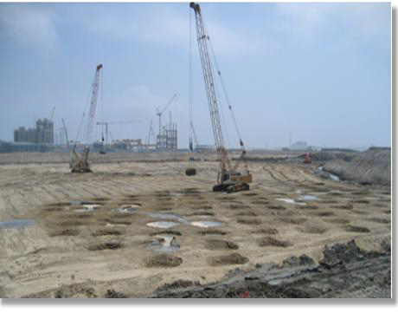
THANK YOU
Head Office
Tel : +82 (0)70 7435 0020
Fax : +82 (0)2 2113 8810
E-Mail : sjtech81@nate.com
Homepage: www.surjintech.co.kr

